Slide 1
Artificial Intelligence Lab Project Submission
Submitted to: Dr.Varun Srivastava
Submitted By : Raghav Sharma(102116102)
Kushal Srivastava(102116097)
Sanchit Raj(102116112)
Namit Sharma(102116105)

Slide 2
Problem Statement: To suggest books to users based on their preferences and interests.
Description of problem:
A book recommendation system is an application that suggests books to users based on their interests, preferences, and reading history. The system recommends the books related to the books that the user has read in past, also suggests books according to the ratings, name of author and year of release. Based on this information, the system predicts what books the user might be interested in reading next and recommends them.

Slide 3
Code and Explanation:
# The following is our approach to the problem.
# 1. Extract all data set from the given folder.
# 2. Extract names from the given data set.
# 3. Compare the books and recommend in csv file.
# 4. Print result.
Data set is to be added before we run the program.
Here’s the link to the folder:
https://drive.google.com/drive/folders/1gW6NXOKvKZb0nZa3ewJPpiXeTLy7OOWL

Slide 4
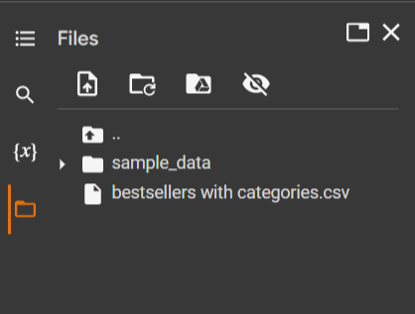
A directory structure can be visualised as in the following snapshot:

Slide 5
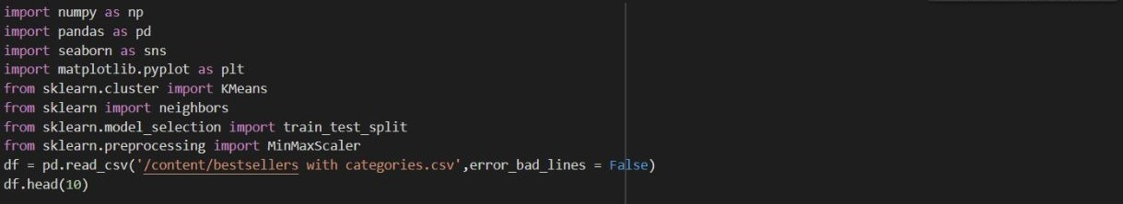
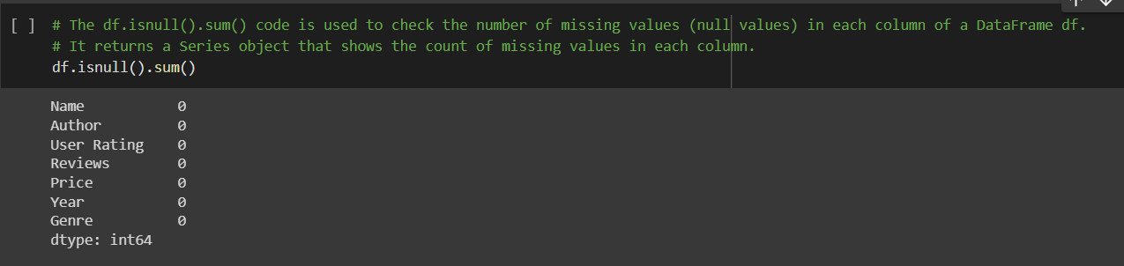
Importing Used modules:

Slide 6
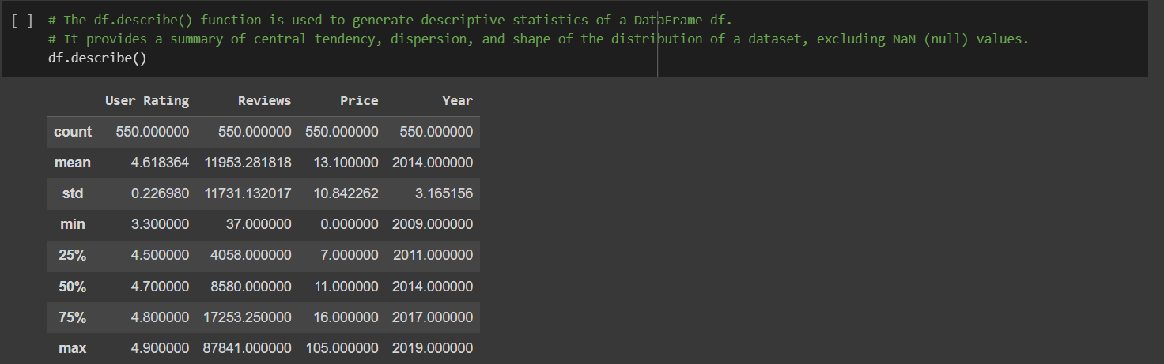

Slide 7
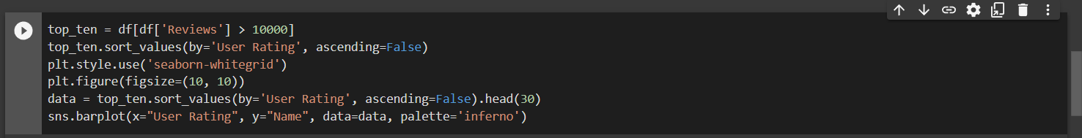
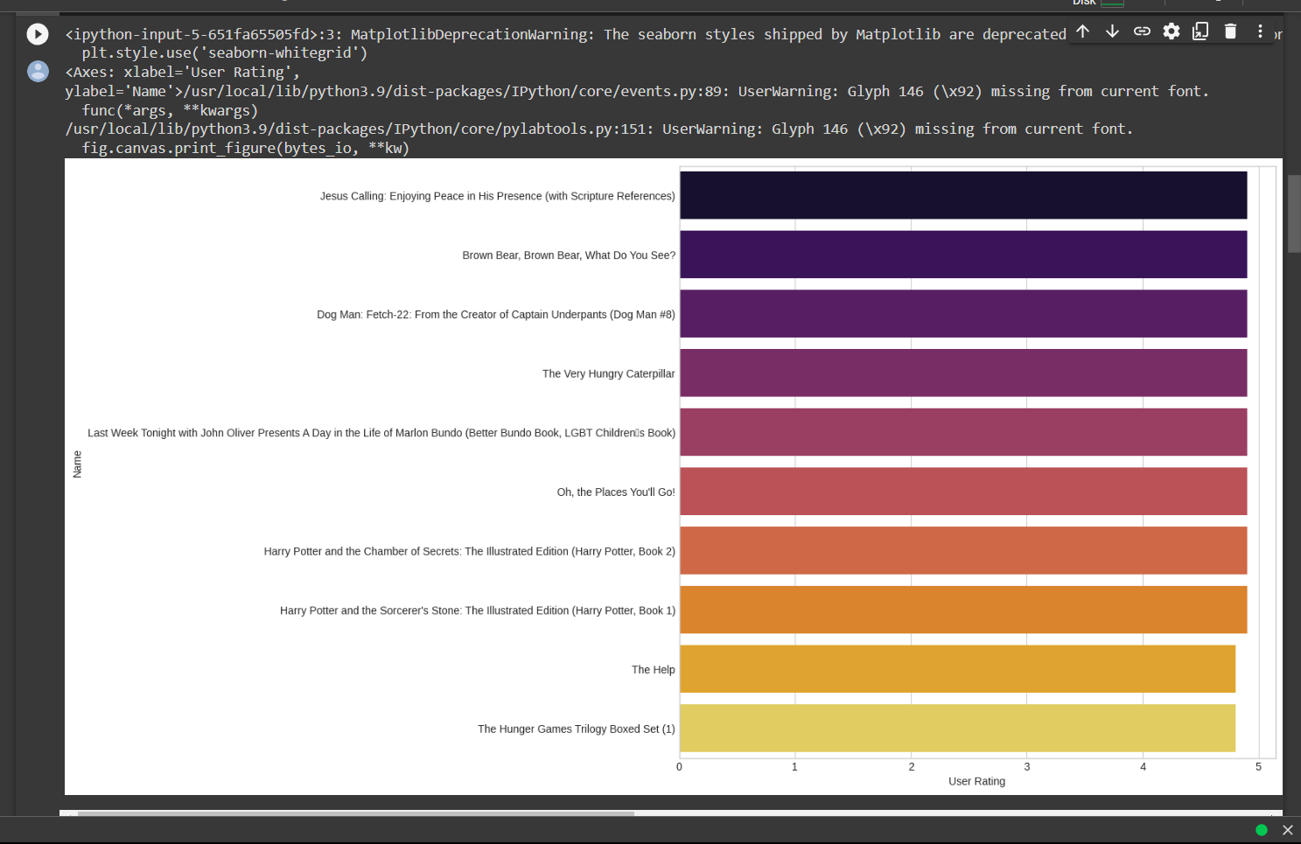
The code provided uses the Pandas and Seaborn libraries for data analysis and visualization.
Selects a subset of a Data Frame called 'df' that includes only the rows where the 'Reviews' column is greater than 10000.
and then creating a bar plot using Seaborn to display the top 30 items from the sorted subset, with the 'User Rating' on
the x-axis and the 'Name' on the y-axis.

Slide 8
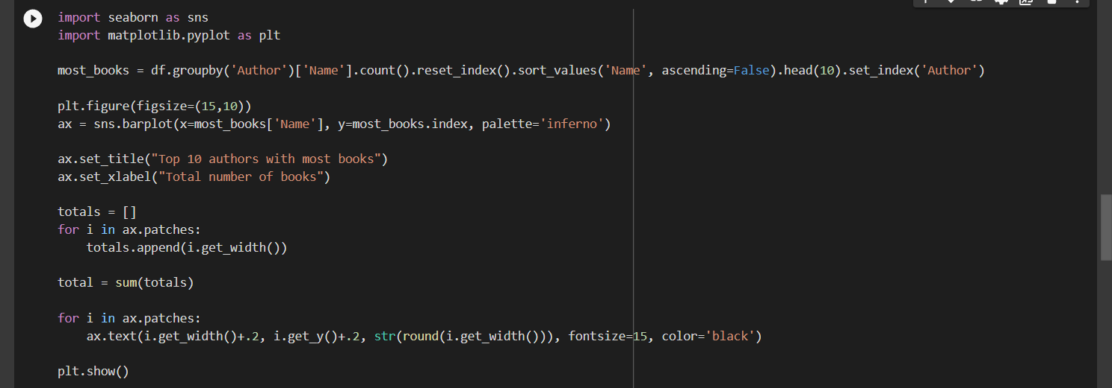
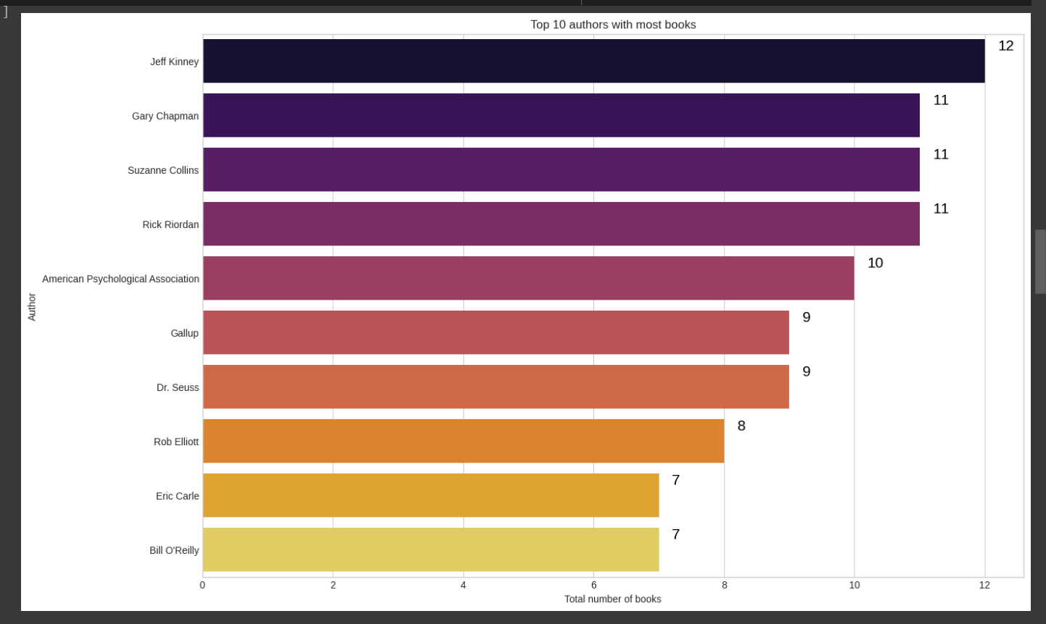
This code creates a bar plot showing the top 10 authors with the most books in a Data Frame called 'df’.
The code then creates a bar plot using Seaborn, where the x-axis represents the total number of books for each author,
and the y-axis represents the author's name. The palette 'inferno' is used to set the color scheme of the plot.

Slide 9
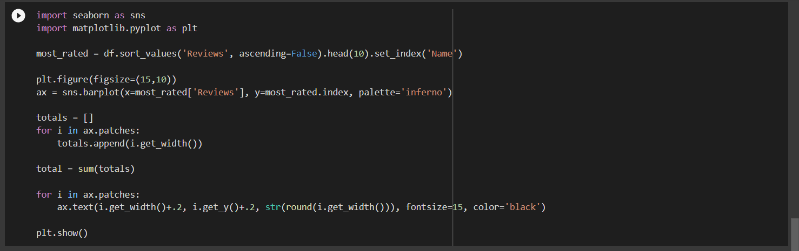
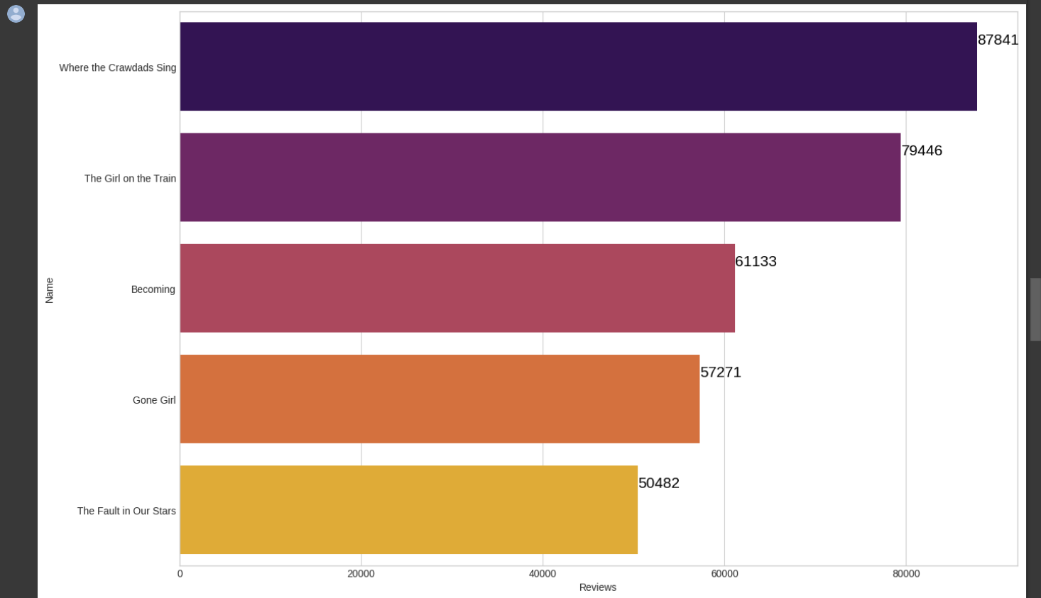
First, the code sorts the Data Frame in descending order based on the 'Reviews' column,
and selects the top 10 rows. Then, it sets the index of the resulting Data Frame to 'Name' to make it easier to plot. The code then creates a bar plot using Seaborn, where the x-axis represents the number of reviews for each book,
and the y-axis represents the book's name. The palette 'inferno' is used to set the color scheme of the plot.

Slide 10
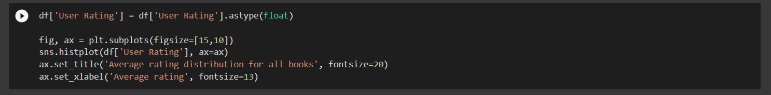
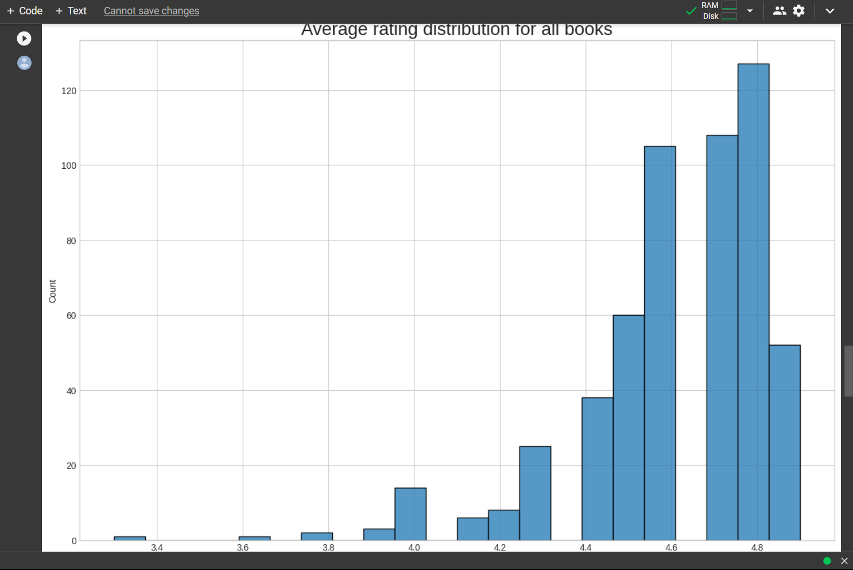
First, the code converts the 'User Rating' column in the DataFrame to a float data type using the ‘astype’ method.
The code then creates a histogram plot using Seaborn's ‘histplot’ function, passing in the 'User Rating' column from the
DataFrame as the data to be plotted. The resulting plot shows the frequency of average rating scores in the DataFrame,
with the x-axis representing the average rating scores and the y-axis representing the frequency of each score.

Slide 11
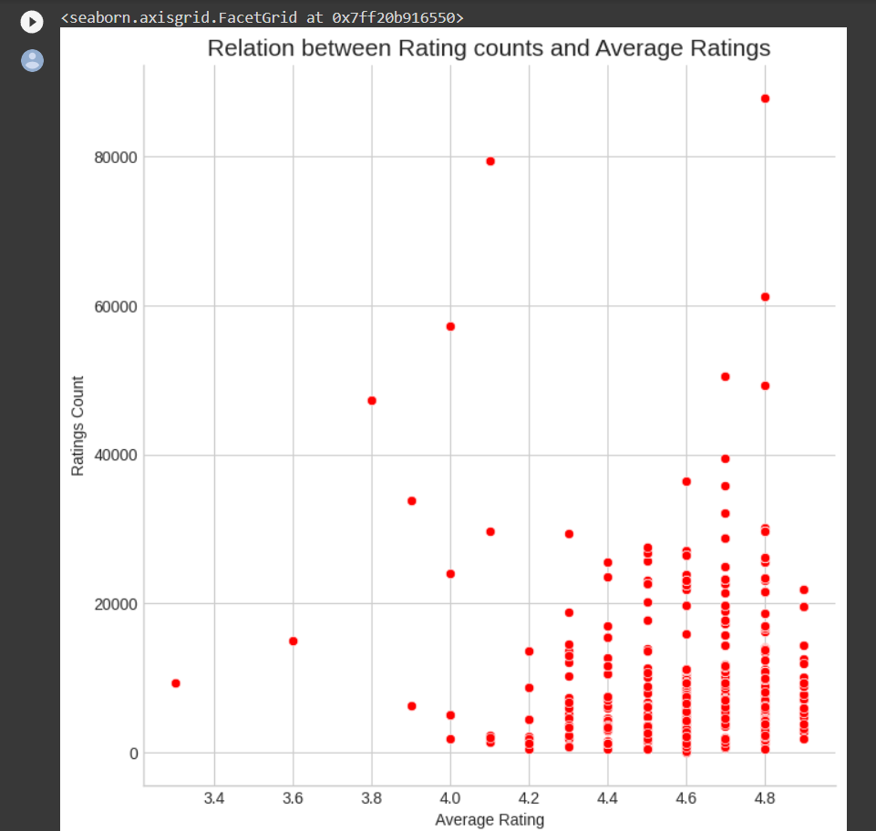
The code uses Seaborn’s ‘relplot’ function to create the scatter plot, passing in the DataFrame as the data source
and specifying the 'User Rating' column as the x-axis and the 'Reviews' column as the y-axis.

Slide 12
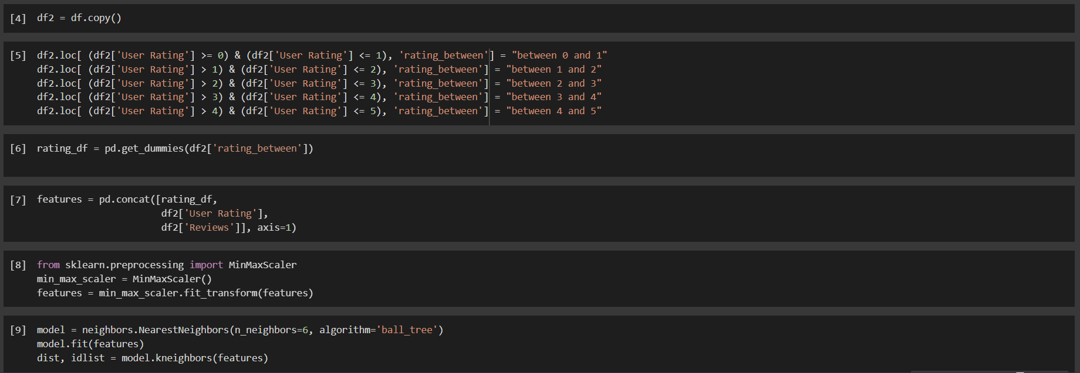
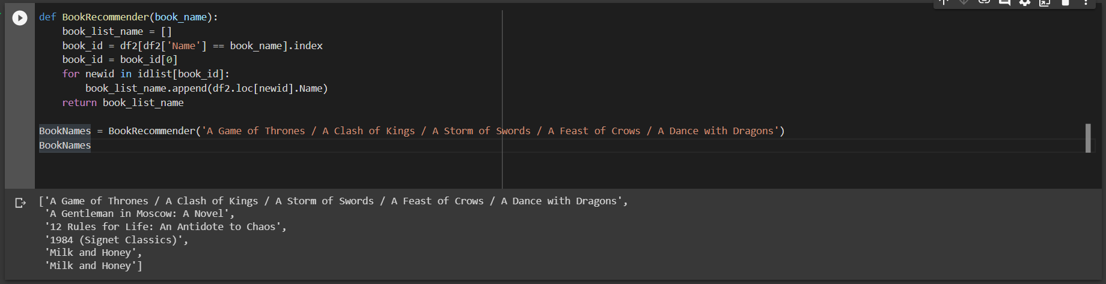
This code recommends books of a particular genre:

